Slide 1


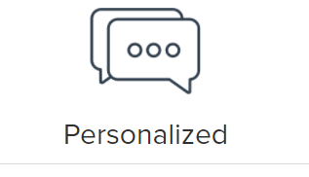


Our Offerings
LOGIN
JOIN for free
Contact Us
Scrolling tiles with Customer feedback
(Examples shown, atleast 5 scolling tiles should be there )
“SOLUGE is one stop destination for my academic problems”
Student from Michigan University
“With SOLUGE it was easy me to understand difficult concepts”
Student from New York University
WHY US?
Full Privacy
Satisfaction Guaranteed
From Ph.D.s to teachers, doctors, professors and Industry experts , Our tutors are best in their domain
Personalized dashboard and approach to your requirement
We maintain full privacy of our customers
We maintain quality of our service above 90%
Continued next slide

Slide 2
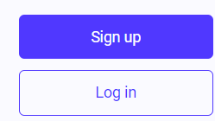
Our Offerings
LOGIN
JOIN for free
Contact Us
In Continuation with previous slide
Make your Problem Simple
Customized Recommendations by SOLUGE will be provided on your requirement
Better Grades
Enhanced final Grades
Using SOLUGE is easy
Easy Three Steps
Share your work
Share your work in which assistance is required
List of all Subjects
About Us
Privacy Policy
Terms of Service
Our Offerings
Upcoming
Support
Contact Us
Report an Issue
Tutor Login
Student Getting Started

Slide 3
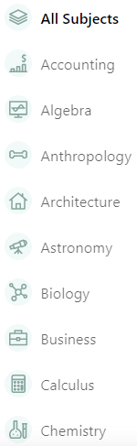
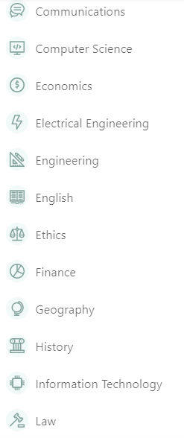
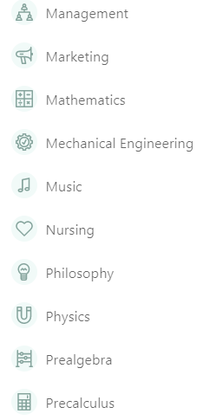
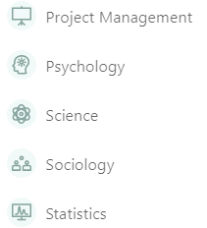
Our Offerings
LOGIN
JOIN for free
Contact Us
University Project
English
Essay Wirting

Slide 4
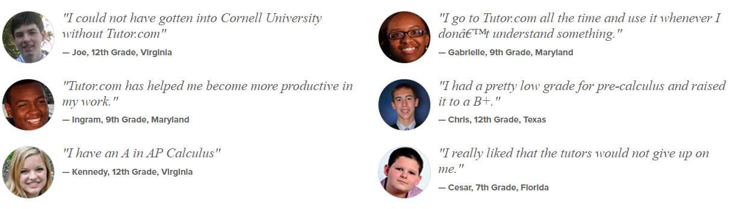


Example Scrolling tiles, Student Feedback
Soluge.com
Newyork
Michigan University

